Slide 1

Real-Time Pothole Detection Using Deep Learning
Project Submitted by:
Alekhya Annam-700755751 Bhuvana Nandhimalla-700744203 Divya Malika Reddy Lakkireddy-700761878 Mani Shankar Reddy Mali-700758500 CS5720: Neural Network & Deep Learning Under the Supervision of Dr.Muhammad Zubair Khan Professor

Slide 2
Team Members: Student ID Role/Responsibilities
Alekhya Annam 700755751 Presentation
Bhuvana Nandhimalla 700744203 Code implementation/execution
Divya Malika Reddy Lakkireddy 700761878 Final report making
Mani Shankar Reddy Mali 700758500 Code implementation/execution

Slide 3
Motivation
The detection of potholes on the road is an important problem to address because it can help prevent accidents, damage to vehicles, and injuries to drivers and passengers. Potholes are one of the most common types of road defects, and they can be difficult to detect and avoid, especially at night or in poor visibility conditions.
Traditional methods of pothole detection often rely on manual inspections, which can be time-consuming and inefficient. Automating this process using deep learning can significantly improve efficiency by quickly scanning roads and identifying areas in need of repair.
Potholes are a ubiquitous problem in both developed and developing countries. Your project has the potential to have a global impact by offering a solution that can be implemented in various regions, regardless of their level of infrastructure development.

Slide 4
Objective
To detect the potholes on the road and avoid the road accidents.
This approach can help road maintenance authorities to formulate rapid and optimized actions for road infrastructure repairs.
Create an intuitive user interface for operators to visualize detected potholes and prioritize repair efforts efficiently.
Conduct thorough testing and evaluation to measure the system's accuracy, reliability, and cost-effectiveness.

Slide 5
Related Work
Data collection: Road images are collected using cameras mounted on vehicles or drones. The images are captured from different viewpoints and lighting conditions to make the dataset diverse.
Data preprocessing: The collected images are preprocessed to remove any noise or distortion. This may involve resizing the images to a fixed size, applying filters to reduce noise, and adjusting the contrast and brightness to improve visibility.
Transfer learning: A pre-trained ResNet50 model is used as a feature extractor to extract features from the preprocessed images. The output from the ResNet50 model is flattened and fed into a fully connected layer to classify whether a pothole is present or not.
Fine-tuning: The last few layers of the ResNet50 model are fine-tuned using the collected dataset to improve the model's accuracy in detecting potholes.
Training: The fine-tuned ResNet50 model is trained using the collected dataset to optimize the model's parameters for pothole detection.
Testing and evaluation: The trained model is tested on a separate set of images to evaluate its accuracy in detecting potholes. Various metrics such as accuracy, precision, recall, and F1 score are used to evaluate the model's performance.

Slide 6
Problem Statement
As we all know how Potholes play a role in causing most of the minor and some major accidents across the globe, having potholes on the roads are very dangerous in any climate.
since it can cause a very serious damage to vehicle’s and even the drivers which can make the vehicle fall apart and causing serious injuries.
So, here is a Pothole detection project which allows us to solve the problem of avoiding potholes where the model which we have generated using transfer learning.

Slide 7
Proposed Solution
Resnet50 is used to detect whether there are any potholes or not on the roads, this Pothole Detection model can be integrated with autopilot vehicle modes which allows the vehicle to avoid potholes.
By leveraging the capabilities of ResNet50, it is possible to develop a robust and accurate pothole detection system that can detect and identify potholes on the road surface with high accuracy.
This system can be integrated into existing road monitoring systems, such as cameras mounted on vehicles or drones, to provide real-time detection and alerts to drivers or road maintenance crews.

Slide 8
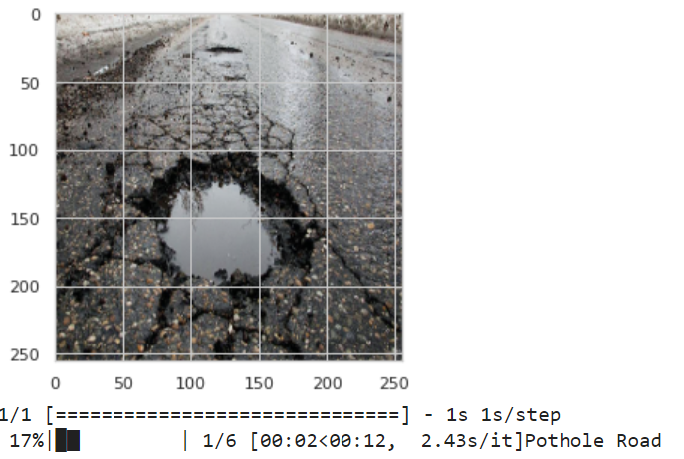
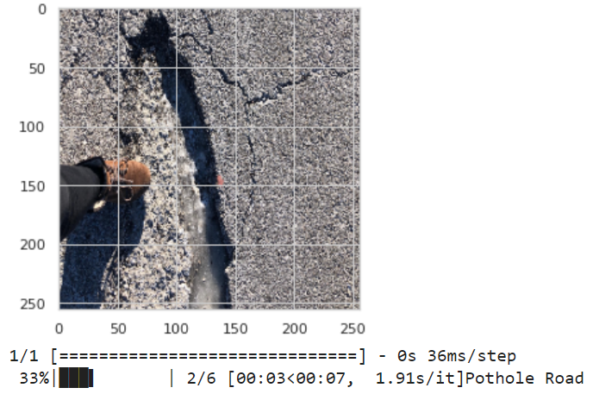
Results

Slide 9
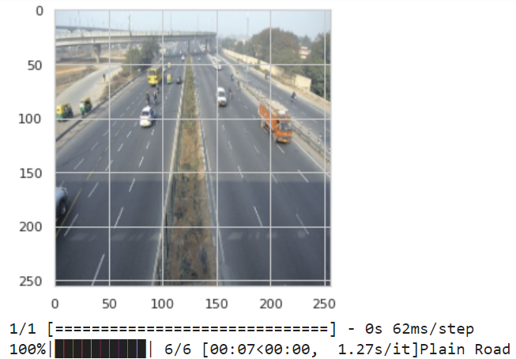
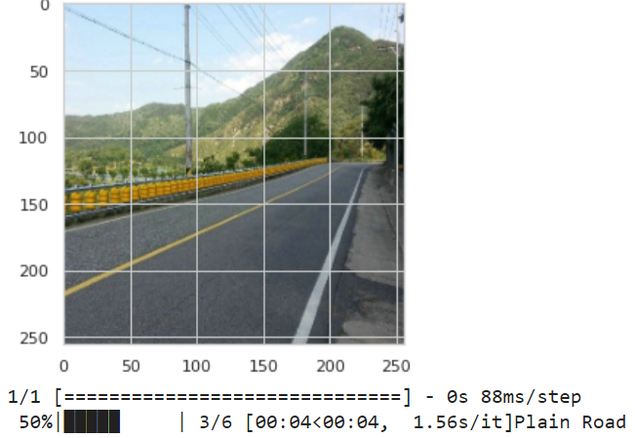
Results

Slide 10
References
G. B. R., C. C., S. B. Rao M., S. M., K. E. and S. J., "Deep Learning Based Pothole Detection and Reporting System," 2020 7th International Conference on Smart Structures and Systems (ICSSS), 2020, pp. 1-6, doi: 10.1109/ICSSS49621.2020.9202061.
R. Rastogi, U. Kumar, A. Kashyap, S. Jindal and S. Pahwa, "A Comparative Evaluation of the Deep Learning Algorithms for Pothole Detection," 2020 IEEE 17th India Council International Conference (INDICON), 2020, pp. 1-6, doi: 10.1109/INDICON49873.2020.9342558.
S. Portal. City of San Antonio: Potholes. [(accessed on 10 September 2020)];2018 Available online: https://www.sanantonio.gov/PublicWorks/FAQs/Streets
A. B. Rani and T. M. Thirumalaisamy, "Pothole detection using transfer learning with ResNet50," 2019 IEEE International Conference on Innovative Research and Development (ICIRD), Kolkata, India, 2019, pp. 1-5, doi: 10.1109/ICIRD.2019.8909629.
C. Wang, L. Chen, H. Liu, and Y. Wei, "Pothole detection using deep transfer learning with ResNet50," 2019 IEEE 3rd International Conference on Computer and Communication Systems (ICCCS), Chengdu, China, 2019, pp. 296-301, doi: 10.1109/CCOMS.2019.8720353.
N. U. Hasan, M. I. Ullah, and M. A. Hossain, "Pothole detection using transfer learning with ResNet50," 2020 5th International Conference on Electrical and Electronics Engineering (ICEEE), Dhaka, Bangladesh, 2020, pp. 1-6, doi: 10.1109/ICEEE49640.2020.9089754.

Slide 11
References
P. Ping, X. Yang and Z. Gao, "A Deep Learning Approach for Pothole Detection," 2020 IEEE Sixth International Conference on Big Data Computing Service and Applications (BigDataService), Oxford, UK, 2020, pp. 198-204, doi: 10.1109/BigDataService49289.2020.00039.
A. Kumar, Chakrapani, D. J. Kalita and V. P. Singh, " Pothole Detection technique using Deep Learning," 2nd International Conference on Data, Engineering and Applications (IDEA), Bhopal, India, 2020, pp. 1-5, doi: 10.1109/IDEA49133.2020.9170705.
Naghsh, A., Daneshvar, S., & Abedi, S. (2021). Pothole Detection and Classification on Road Surface using Transfer Learning and Deep Learning. Proceedings of the 2021 5th International Conference on Computer and Knowledge Engineering (ICCKE), 55-60. https://doi.org/10.1109/ICCKE52677.2021.9436484

